Slide 1
Asking Testable Analytical Question
Saryu Onishi
HES 3000-002, Sport Performance Analytics
Notes:
Overview of the three domains (Tracking, Scouting, Strategy) and how data changes sports decisions.

Slide 2
Start With Something You Notice
Think of one observation, concern, or belief about sport that you would like to investigate.
Examples:
“Our team fades late in games.”
“This prospect looks better than the statistics suggest.”
“Some athletes do not recover well after hard practices.”
Write yours in one sentence. Does not need to be a formal question yet.
Notes:
Give students 90 seconds to write independently, then ask them to share with a partner. Collect two or three examples for use later in the lecture. The purpose is to begin with their sports thinking rather than analytical terminology.

Slide 3
Analysis must start with clarity
“Our team fades late in games” leaves several things unresolved:
What does fades mean?
Which team, players, games, or situations?
Compared with what?
What evidence would support or challenge the belief?
What decision would change if the belief were true?
The starting point must be observable and the purpose must be clear.
Notes:
Do not frame the original statement as bad. It is useful practitioner knowledge, but it is not yet precise enough to guide data collection or analysis.

Slide 4
Good Questions Connect Curiosity to a Decision
A useful analytical question identifies:
The decision or purpose : Why do we need the answer?
The outcome : What are we trying to understand?
The comparison : Relative to whom, what, or when?
The context : Under which conditions?
The evidence : What observations could answer it?
The question is the bridge between the sport problem and the analysis.
Notes:
Briefly connect this to the prior class: the domain tells us where the problem lives, and the analytical purpose tells us what kind of answer is needed. Today focuses on making the question answerable.

Slide 5
Begin With the Decision
“I want to know whether our players are tired.”
Possible decisions include:
Should today's practice be modified?
Should a player's minutes be restricted tomorrow?
Should the weekly training plan change?
Should the team adopt a new recovery strategy?
The same concern can lead to different questions because the decisions are different.
Notes:
Ask students what information would matter for each decision. Highlight how timeframe, comparison, and acceptable uncertainty change with the decision.

Slide 6
Define the Outcome Before Choosing the Metric
“tired” could refer to fatigue, which could mean:
Reduced physical performance
Increased perceived effort
Muscle soreness
Lower motivation or alertness
Incomplete recovery from recent training
A metric represents one part of a concept; it is not automatically the concept itself.
Notes:
Use this to introduce operationalization without relying heavily on the term. A countermovement-jump metric, wellness score, or heart-rate response may provide evidence about fatigue, but none is a universal fatigue detector.

Slide 7
Comparisons Give Numbers Meaning
Consider: “Did the athlete complete a high workload?”
High compared with:
The athlete's usual workload?
The planned workload?
Teammates at the same position?
Competition demands?
A threshold associated with a particular goal?
Without a reference point, “high,” “low,” “good,” and “poor” are usually empty labels.
Notes:
Ask which comparison would be most appropriate if the decision is whether to modify tomorrow's training. There may be more than one defensible answer; require students to connect their choice to the decision.

Slide 8
Context Determines What the Comparison Means
The same performance value may mean something different depending on:
Position or role
Opponent quality
Game state
Training phase
Injury or return-to-play status
Age and competition level
Useful questions define just enough context to make the answer interpretable.
Notes:
Avoid turning this into a demand to include every possible variable. The goal is to identify context that is material to the question.

Slide 9
From Concern to Question
During conference games this season, did our team's scoring efficiency decline in the fourth quarter compared with the first three quarters?
This revision defines:
Outcome = scoring efficiency
Comparison = fourth quarter versus earlier quarters
Context = conference games
“Our team fades late in games.”
and is the pattern different in close games?
What else needs to be resolved?
Notes:
Ask what remains unresolved. Possible answers include the definition of scoring efficiency, the definition of a close game, whether overtime is included, and what decision the analysis would inform. Emphasize that questions can be refined iteratively.

Slide 10
Precision Does Not Mean Small Questions
What makes a basketball team successful?
How does turnover rate relate to offensive efficiency across conference games?
Did the turnover with 1:12 remaining in Q3 cause Tuesday's loss?
Too Broad
Focused
Too Narrow
A useful scope is narrow enough to investigate reasonably and broad enough to matter.
Notes:
scope depends on the decision, available observations, and the level of confidence needed. Narrower is not automatically better.

Slide 11
Warning on Causal Language
The wording of the question should match what the evidence can support.
Was greater workload associated with poorer shooting?
Did greater workload cause poorer shooting?
Did poorer shooting occur after periods of greater workload?
Do players with greater workload tend to shoot worse?
Notes:
relationship, sequence, or group difference does not by itself establish causation. Keep the discussion conceptual; causal inference will be revisited later.

Slide 12
Activity: Diagnose the Question
“Does time spent training affect performance?”
With your group, identify what is missing or ambiguous:
What decision or purpose?
What outcome?
What comparison?
Which athletes and timeframe?
What does “affect” claim?
Then rewrite the question.
Notes:
Allow 3 minutes for group work and 2 minutes for discussion. Accept several defensible revisions. Listen for students treating PlayerLoad as both the construct and the measure, leaving performance undefined, or retaining causal language without a design that could support it.

Slide 13
EXAMPLE solution
Decision
Should the coaching staff modify practice volume before games?
Question
“Among players who appear in at least 15 minutes, is PlayerLoad accumulated during the two days before a game associated with fourth-quarter shooting efficiency?”
Still open for refinement
Is PlayerLoad the most relevant measure?
Is shooting efficiency the right outcome?
What other context might explain the relationship?

Slide 14
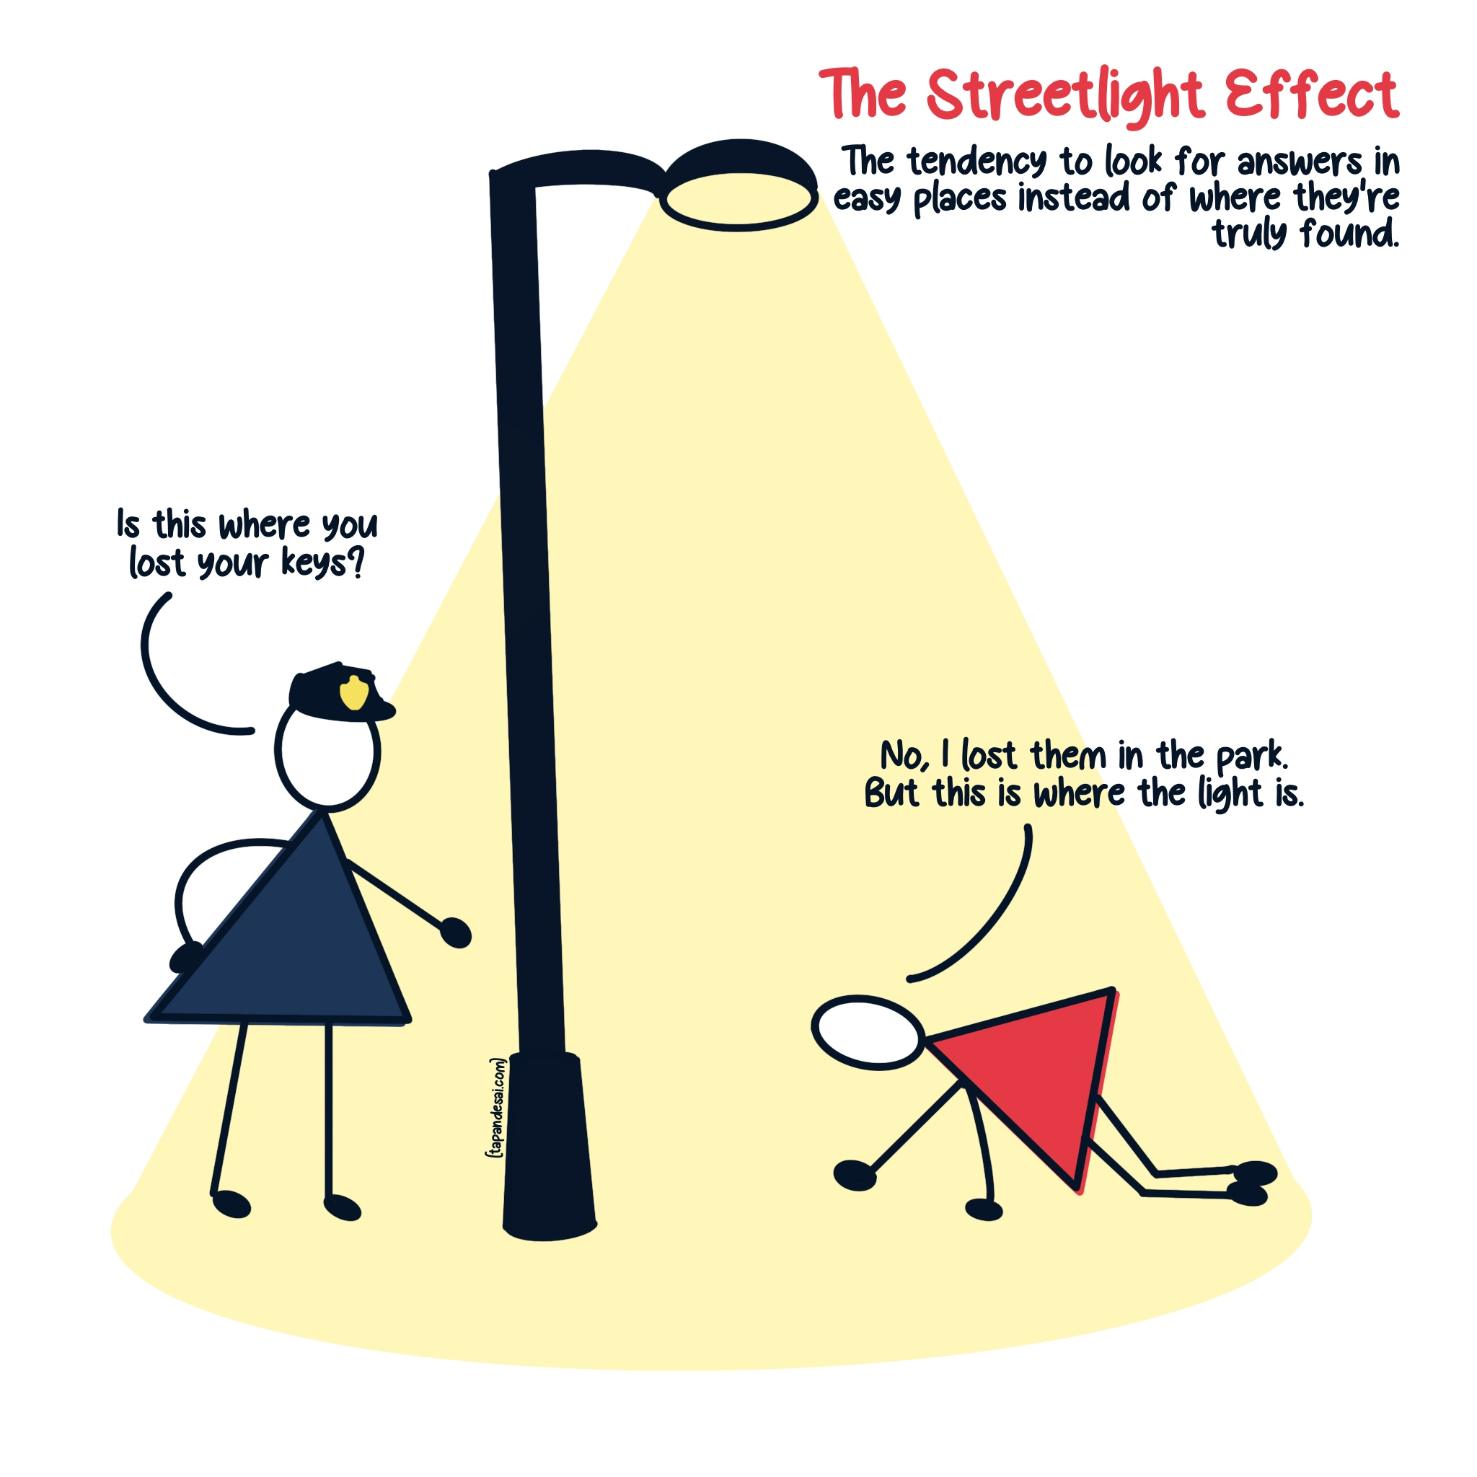
The Streetlight Effect
Notes:
Briefly tell the streetlight story: someone searches for lost keys under a streetlight because the light is better there, even though the keys were lost elsewhere. Connect the metaphor to convenient sport datasets.

Slide 15
Available Data Can Rewrite Questions
Original concern
Why does the team struggle to create good shots against zone defense?
Available spreadsheet
Points, rebounds, assists, and minutes
Convenient replacement question
Who scores the fewest points?
The replacement is answerable, but it does not answer the original concern.
Notes:
Ask what information might be more relevant: possession type, shot location, defensive alignment, ball movement, video, or play-by-play sequence.
The appropriate response may be to collect different data, narrow the claim, or admit the current data cannot answer the question.

Slide 16
Data Availability Matters (But It Should Not Lead)
Practical Steps:
Define the sport concern and decision.
Write the ideal question.
Identify the evidence the question requires.
Inspect what data are actually available.
Revise the scope without changing the question's purpose.
State what the available data cannot establish.
Step 5 should refine the question, not replace it.
Notes:
analysts cannot ignore feasibility. The problem is when when convenience becomes the rationale for the analysis.

Slide 17
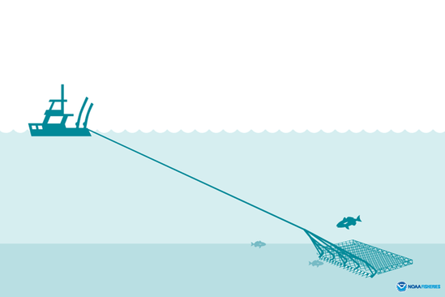
Data Dredging
probing data using unplanned analyses and then reporting salient results without accurately describing the processes by which the results were generated. (Erasmus, Holman & Ioannidis , 2022 )

Slide 18
Data Dredging
Most often done by repeated statistical testing
Can produce misleading or false conclusions
“We have GPS data. What relationships can we find?”
Statistically likely that you will find a significant relationship

Slide 19
Exploratory Analysis
This is a legitimate analytical pursuit but stops at descriptive analytics.
Valid diagnostic, predictive and prescriptive analytics requires direction from the start.

Slide 20
A Question Can Be Useful Even If the Answer Is “We Cannot Tell”
Sometimes the conclusion of an investigation may be:
The required variable was not measured.
The comparison group is inappropriate.
The sample is too limited.
The measurement does not represent the intended concept.
The design cannot support the claimed explanation.
Recognizing limits is a crucial part of analytics

Slide 21
Group Project
Your group will develop a sport analytics project that connects:
A sport observation, concern, or decision
A focused analytical question
Appropriate and obtainable data
An analysis that matches the question
A clear interpretation for the intended audience
Your project is not “analyze a dataset”. The dataset is evidence for a question.

Slide 22
CS1: Establish the Project Direction
With your group, identify:
A sport and domain that interests you
A real observation, concern, or decision
Who would use the answer
An initial analytical question
The ideal evidence needed
Data sources that may be feasible
Keep the concern (step 2) and the question (step 4) separate

Slide 23
Is the Question Ready to be Pursued?
Before committing, ask:
Does the answer matter to someone?
Is the outcome clearly defined?
Is there a meaningful comparison?
Is the scope realistic?
Could evidence challenge our initial belief?
Are we answering the concern—or merely using convenient data?

Slide 24
Summary & Looking Ahead
Start with a sport concern or decision.
Define the outcome, comparison, and context.
Use causal language only when the evidence supports it.
Let feasibility refine the scope without replacing the purpose.
Treat limitations as part of the answer.
Next: at-home case study (generate question and identify dataset)

